Slide 1
MA206 – Probability and Statistics Lesson 19 – Two Quantitative Variables

Slide 2
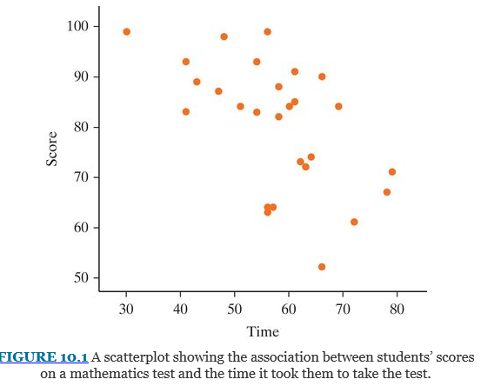

Slide 3
r = -0.57

Slide 4
r = -0.57

Slide 5


$$\overline{y}$$
Residual
r = -0.57
$$\hat{y}=β_{0}+β_{1}×(time)$$

Slide 6

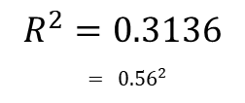
r = -0.56
$$\hat{y}=114.5 −0.55×(time)$$
$$R^{2}=0.3136$$
$= {0.56}^{2}$

Slide 7
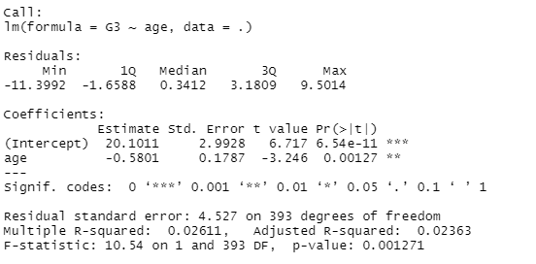






Reading the R Output
H₀: There is NO association between explanatory and response variable
H_{a}: There IS an association between explanatory and response variable
Response
Explanatory
$$β_{1}=0$$
$$β_{1}≠0$$
P-value = 0.00127
$${\hat{β}}_{1}=−0.5801$$
$$t−stat=−3.246$$
$$R^{2}=.02611$$
SE(${\hat{β}}_{1}$)

